Slide 1
Class diagram

Slide 2
UML
The Unified Modeling Language (UML) is a general-purpose, developmental, modeling language in the field of software engineering, that is intended to provide a standard way to visualize the design of a system.
UML 2.0 major revision replaced version 1.5 in 2005. UML 2.x

Slide 3
UML
Every UML diagram belongs to one these two diagram categories. The purpose of structure diagrams is to show the static structure of the system being modeled. They include the class, component, and or object diagrams. Behavioral diagrams, on the other hand, show the dynamic behavior between the objects in the system, including things like their methods, collaborations, and activities. Example behavior diagrams are activity, use case, and sequence diagrams.

Slide 4
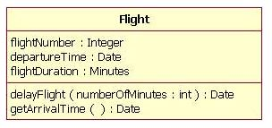
Class diagram
The UML representation of a class is a rectangle containing three compartments stacked vertically. The top compartment shows the class's name. The middle compartment lists the class's attributes. The bottom compartment lists the class's operations. When drawing a class element on a class diagram, you must use the top compartment, and the bottom two compartments are optional.

Slide 5
Class attribute
The attribute section of a class (the middle compartment) lists each of the class's attributes on a separate line. The line uses the following format:
name : attribute type
Sometimes it is useful to show on a class diagram that a particular attribute has a default value.
name : attribute type = default value

Slide 6
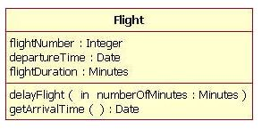
Class method
Like the attributes, the operations of a class are displayed in a list format, with each operation on its own line. Operations are documented using the following notation:
name(parameter list) : type of value returned

Slide 7
Inheritance
A very important concept in object-oriented design, inheritance, refers to the ability of one class (child class) to inherit the identical functionality of another class (super class), and then add new functionality of its own.
To model inheritance on a class diagram, a solid line is drawn from the child class (the class inheriting the behavior) with a closed, unfilled arrowhead (or triangle) pointing to the super class.

Slide 8
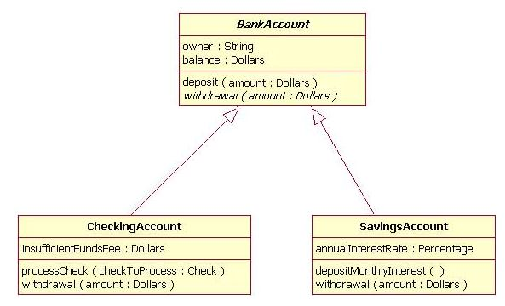

Slide 9
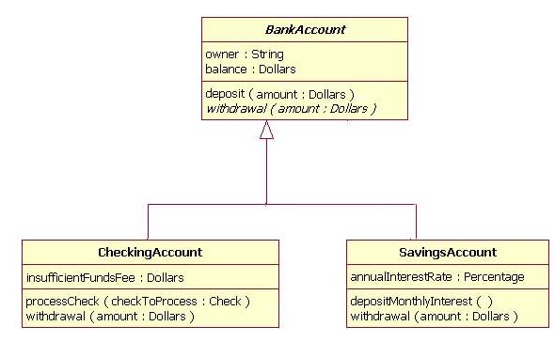

Slide 10
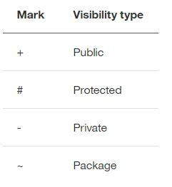
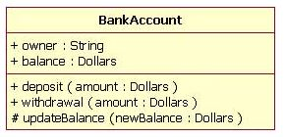
Visibility
In object-oriented design, there is a notation of visibility for attributes and operations. UML identifies four types of visibility: public, protected, private, and package.

Slide 11
Tools for Class diagram
StarUML
Microsoft visio

Slide 12
In DIU library students can borrow books. Books have different properties like ID, Name, category, availability. Before issuing a book, books availability is checked. Available books are issued to the students, for unavailable book no books are available is showed. Each student has ID and Name. Now, design a class diagram based on the above scenario.

